Slide 1
Foundations of Machine Learning
Module 6: Neural Network
Part A: Introduction
Sudeshna Sarkar
IIT Kharagpur

Slide 2
Introduction
Inspired by the human brain.
Some NNs are models of biological neural networks
Human brain contains a massively interconnected net of 10¹⁰-10¹¹ (10 billion) neurons (cortical cells)
Massive parallelism – large number of simple processing units
Connectionism – highly interconnected
Associative distributed memory
Pattern and strength of synaptic connections

Slide 3
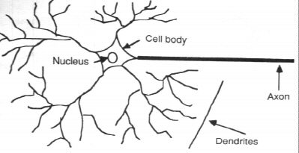
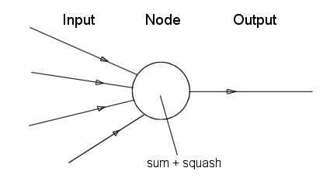
Neuron
Neural Unit

Slide 4
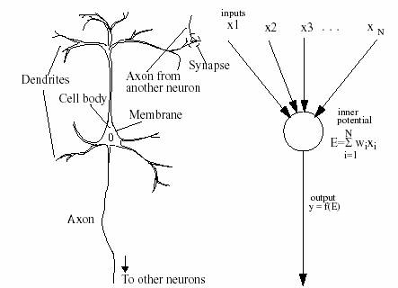
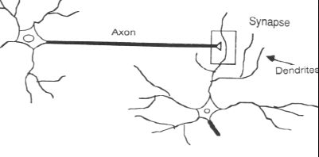
ANNs
ANNs incorporate the two fundamental components of biological neural nets:
Nodes - Neurones
Weights - Synapses

Slide 5
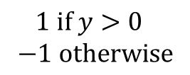
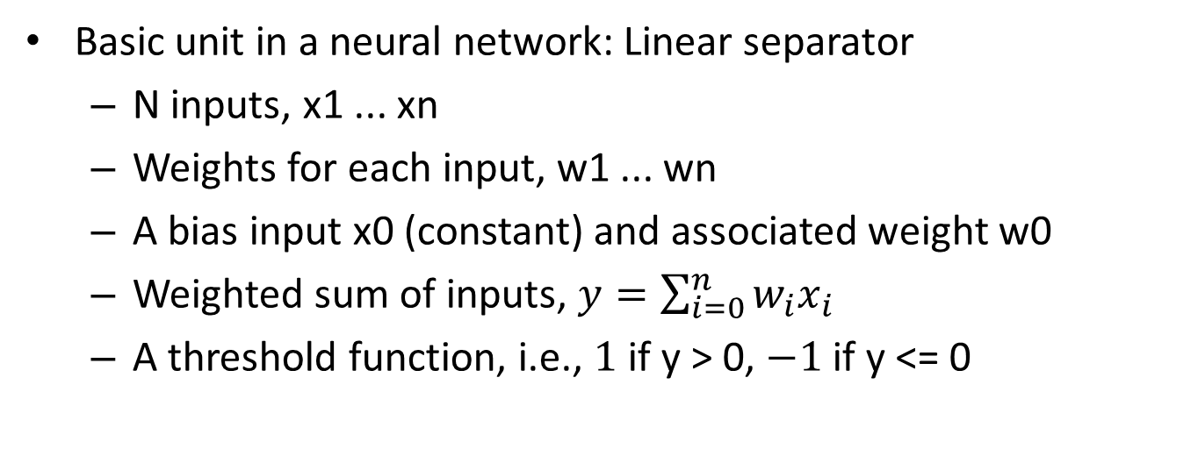
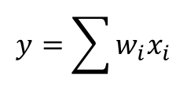

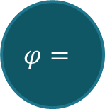

Perceptrons
Basic unit in a neural network: Linear separator
N inputs, x1 ... xn
Weights for each input, w1 ... wn
A bias input x0 (constant) and associated weight w0
Weighted sum of inputs, $y=\sum_{i=0}^{n}{w_{i}x_{i}}$
A threshold function, i.e., $1$ if y > 0, $−1$ if y <= 0
x0
x1
w1
w0
x2
w2
$$Σ$$
$$φ=$$
$$⋮$$
wn
$$y=\sum{w_{i}x_{i}}$$
$1 \text{if} y>0$ $$−1 \text{otherwise}$$
xn

Slide 6
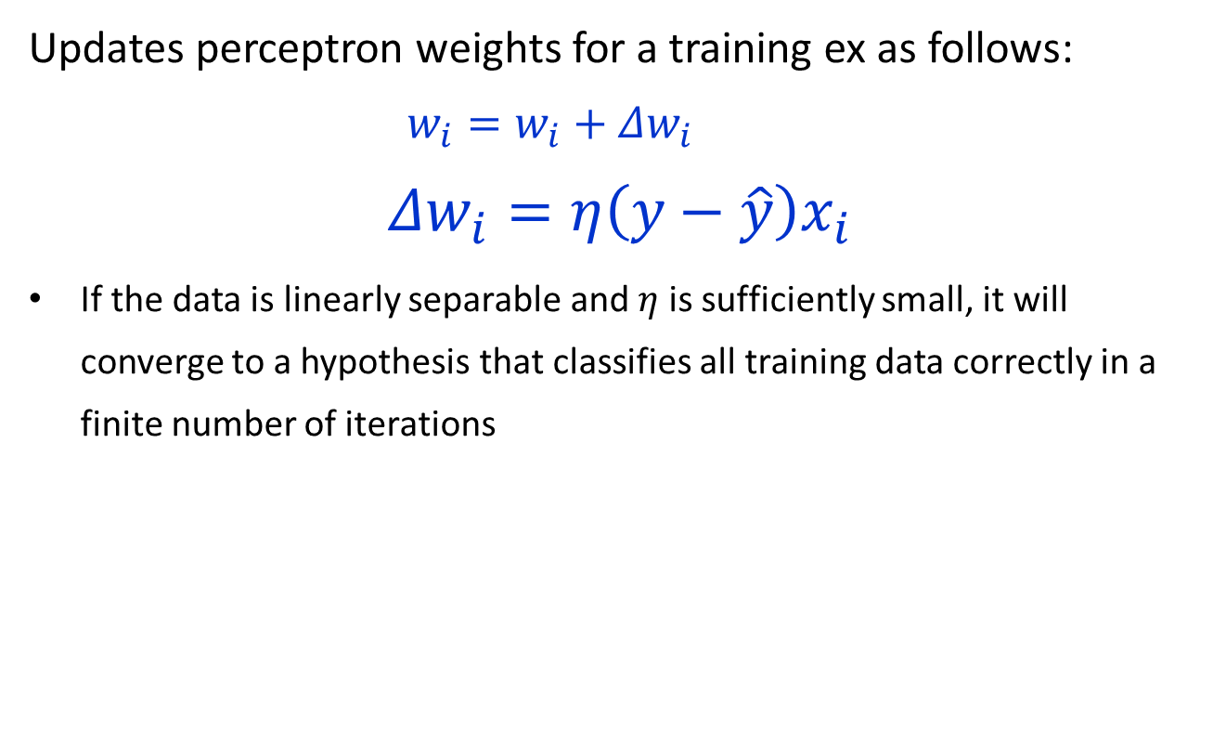
Perceptron training rule
Updates perceptron weights for a training ex as follows:
$$w_{i}=w_{i}+Δw_{i}$$
$$Δw_{i}=η\left(y−\hat{y}\right)x_{i}$$
If the data is linearly separable and $η$ is sufficiently small, it will converge to a hypothesis that classifies all training data correctly in a finite number of iterations

Slide 7
Gradient Descent
Perceptron training rule may not converge if points are not linearly separable
Gradient descent by changing the weights by the total error for all training points.
If the data is not linearly separable, then it will converge to the best fit
all training points, rather than the individual
If the data is not linearly separable, then it will .converge to the best fit/

Slide 8
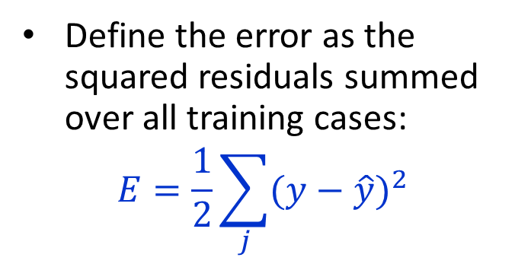
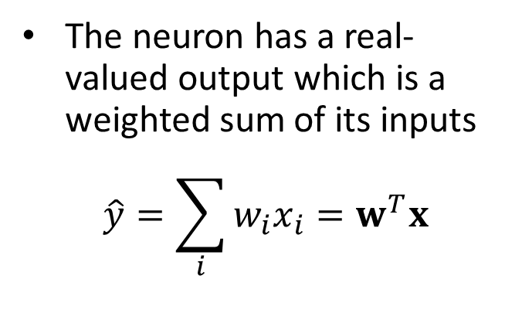
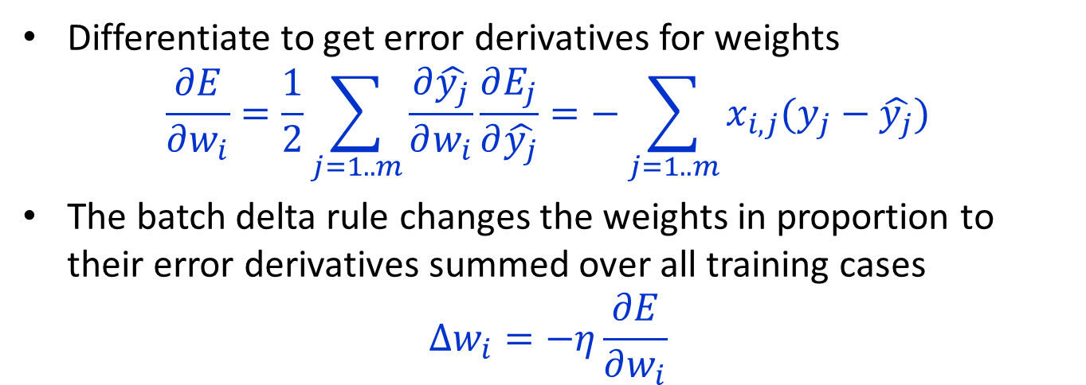
Linear neurons
The neuron has a real-valued output which is a weighted sum of its inputs
$$\hat{y}=\sum_{i}{w_{i}x_{i}}=w^{T}x$$
Define the error as the squared residuals summed over all training cases:
$$E=\frac{1}{2}\sum_{j}{{(y−\hat{y})}^{2}}$$
Differentiate to get error derivatives for weights
$$\frac{∂E}{∂w_{i}}=\frac{1}{2}\sum_{j=1..m}{\frac{∂\hat{y_{j}}}{∂w_{i}}\frac{∂E_{j}}{∂\hat{y_{j}}}}=−\sum_{j=1..m}{x_{i,j}(y_{j}−\hat{y_{j}})}$$
The batch delta rule changes the weights in proportion to their error derivatives summed over all training cases
$$∆w_{i}=−η\frac{∂E}{∂w_{i}}$$

Slide 9
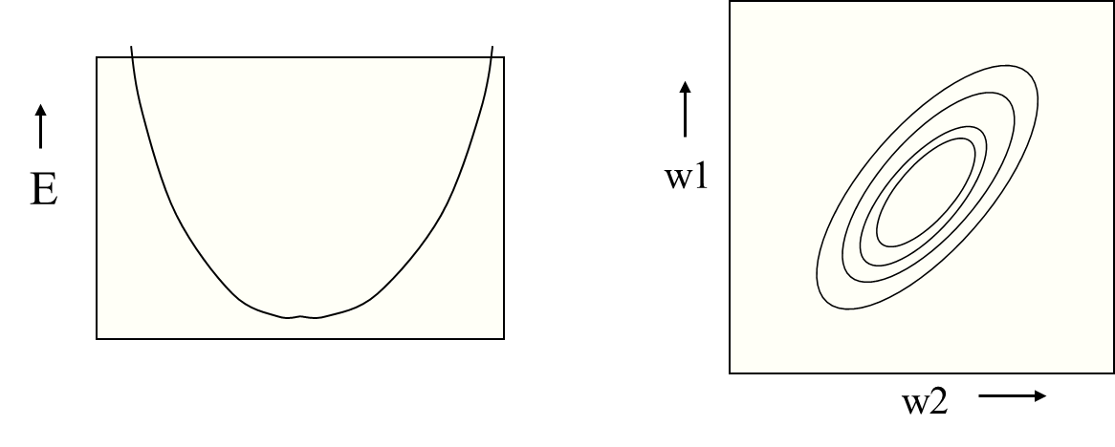
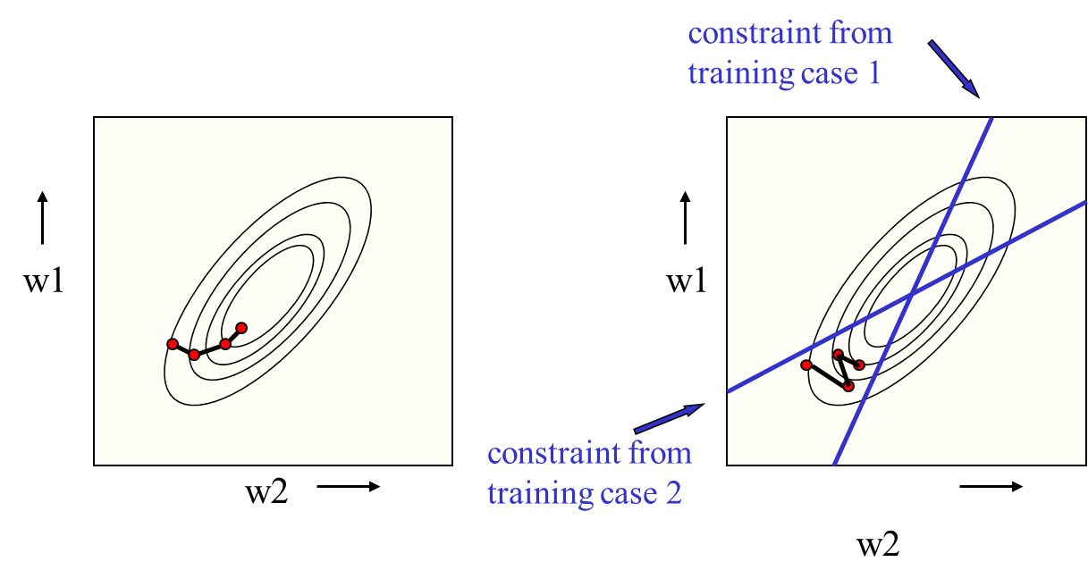
Error Surface
The error surface lies in a space with a horizontal axis for each weight and one vertical axis for the error.
For a linear neuron, it is a quadratic bowl.
Vertical cross-sections are parabolas.
Horizontal cross-sections are ellipses.

Slide 10
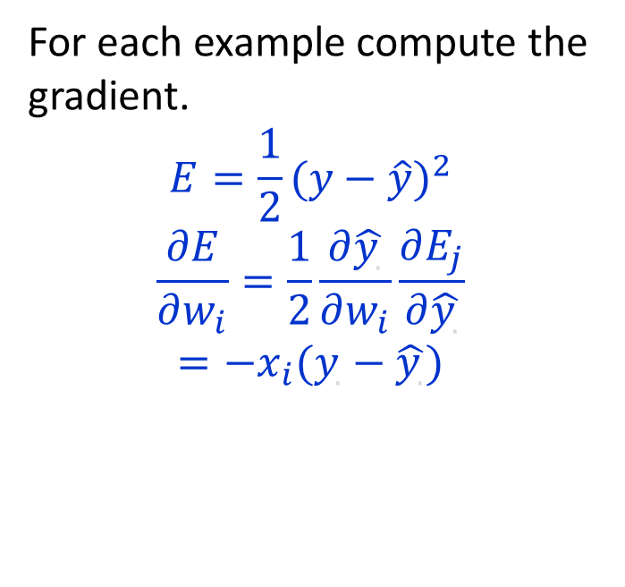
Batch Line and Stochastic Learning
Batch Learning
Stochastic/ Online Learning
Steepest descent on the error surface
For each example compute the gradient.
$$E=\frac{1}{2}{(y−\hat{y})}^{2}$$
$$\frac{∂E}{∂w_{i}}=\frac{1}{2}\frac{∂\hat{y_{.}}}{∂w_{i}}\frac{∂E_{j}}{∂\hat{y_{.}}}$$
$$=−x_{i}(y_{.}−\hat{y_{.}})$$

Slide 11
Computation at Units
Compute a 0-1 or a graded function of the weighted sum of the inputs
is the activation function

Slide 12
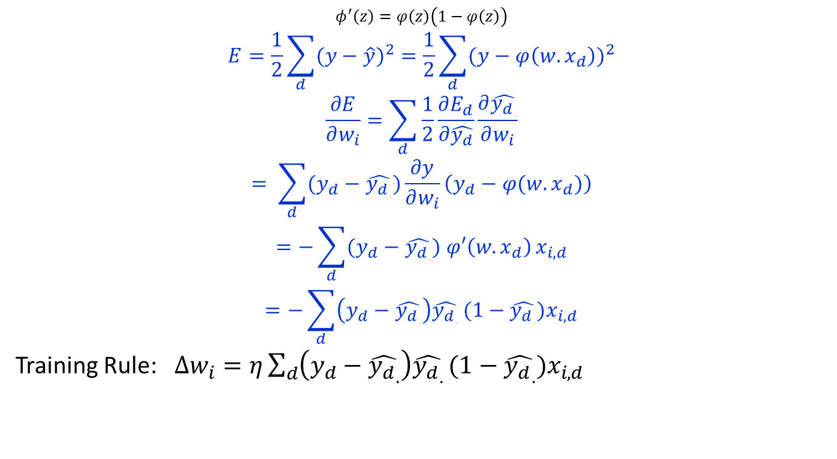
Neuron Model: Logistic Unit
$$φ^{′}\left(z\right)=φ\left(z\right)\left(1−φ\left(z\right)\right)$$
$$E=\frac{1}{2}\sum_{d}{{(y−\hat{y})}^{2}}=\frac{1}{2}\sum_{d}{{(y−φ\left(w.x_{d}\right))}^{2}}$$
$$\frac{∂E}{∂w_{i}}=\sum_{d}{\frac{1}{2}\frac{∂E_{d}}{∂\hat{y_{d}}}\frac{∂\hat{{y_{d}}_{.}}}{∂w_{i}}}$$
$$= \sum_{d}{(y_{d}−\hat{{y_{d}}_{.}})\frac{∂y}{∂w_{i}}\left(y_{d}−φ(w.x_{d})\right)}$$
$$=−\sum_{d}{(y_{d}−\hat{{y_{d}}_{.}}) φ′\left(w.x_{d}\right)}x_{i,d}$$
$$=−\sum_{d}{\left(y_{d}−\hat{{y_{d}}_{.}}\right)\hat{{y_{d}}_{.}}}(1−\hat{{y_{d}}_{.}})x_{i,d}$$
Training Rule: $∆w_{i}=η\sum_{d}{\left(y_{d}−\hat{{y_{d}}_{.}}\right)\hat{{y_{d}}_{.}}}(1−\hat{{y_{d}}_{.}})x_{i,d}$

Slide 13
Thank You

